Slide 1
Ka ora Ka ako
Healthy
School
Lunches
Notes:
Under current government, their priorities ask us to lose te reo Maori title, and from 11 years old we also lose the Health
standards and the Lunches part of the programme. Once again Schools are left to make the unworkable work.

Slide 2
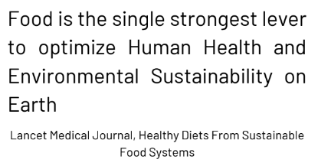
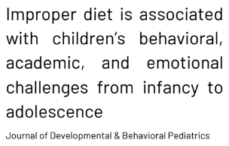
Fact Check 1: “There is no research to support lunches having a positive impact on learning.”
A healthy diet is a foundation for health, well-being, optimal growth and development…The benefits of a healthy diet are reflected in higher educational outcomes, productivity and lifelong health.
World Health Organisation /health topics/healthy diets

Slide 3
Fact Check 1: “The implications”
Increased frequency and intensity of behavioural impacts on learners.
Increased frequency and intensity of developmental impacts on learners.
Negative impacts on environmental sustainability.
Increased societal costs for decreased health and well being of our people.
Decreased educational outcomes.
Decreased economic productivity.

Slide 4
Fact Check 2: “Schools will receive $3 per yr 7-13 student to continue the Lunches programme”
Schools will receive no money for the yr 7-13 lunches programme in 2025.
“MOE will receive this funding” instead and schools are likely to receive an online credit.

Slide 5
Fact Check 2: “The implications”
Volume purchasing may enable the purchase of enough food for daily lunches. Any shortfall will mean less food or school topping this up.
Schools will need to fund staffing, packaging, delivery (if more than 1 site), waste management, operating costs and maintenance from our Operations grant, meaning there will be less resourcing for teaching and learning in schools.
If schools do not already have kitchen facilities, they will not be funded for resources to prepare or serve the food.

Slide 6
Fact Check 3: “Schools can order ready to eat sandwiches.”
All subject to tendering but at the price point and even at volumes:
“It is unlikely sandwiches can be provided.”
“It is unlikely fresh food can be delivered daily.”
Notes:
Source: MOE follow up online hui Friday 17 May

Slide 7
Fact Check 3: “The implications”
To prepare food on site, schools must go through the food control plan and certification process, otherwise food cannot be served to kids.
Schools will only be able to provide long life, processed and pre-packaged snack foods.

Slide 8
A Quick Comparison @ Tairangi School
Year 0-6
Existing Healthy Food Standards based on MOH recommendations
$122,000, 56% food 44% provision
Year 7-8
New Health standards based on the food available for provision.
From:
$58,000, 56% ($32,000) food
44% ($26,000) provision
To:
$26,000, -$6,000 food (-20%)
-$26,000 provision (-100%)

Slide 9
Implications @ Tairangi School
We will need to find $26,000 - $32,000 per year to continue.
Food purchased through MOE system will not meet their own Health requirements for year 0-6 students, meaning we cannot provide food ordered through the site to yr 0-6 students.
We now need to provide 2 different lunches.
Yr 0-6 students will get lower quality food as we use this finding to cover provision costs for yr 7-8.
Yr 7-8 students learn about commercial cooking from our chef and could otherwise be asked to prepare food, which they are not eating.
It is only a matter of time before the assets depreciate and we cannot afford the replacement of the $20,000 worth of kitchen equipment MOE required us to have to operate the kitchen.

Slide 10
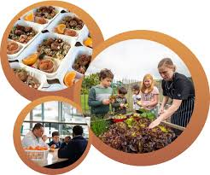
Funded to Fail
Lunches have not been “saved” for yr 7-13 students.
We have been “intentionally underfunded” to cause schools to have to close the programmes and MOE and the Minister can pretend it was the schools decision.
Make no mistake. The lunches programme in its proposed 2025 funding model will mean our most vulnerable students in society will now not receive food and schools will stop delivering the programme.
What wouldn’t you do if you and your kids didn’t eat
today and you have no food for tomorrow?

